Slide 1
Lab 8: Preliminary Data Review
2/3 Body Problem
C2C Gowri Ramaprasad
C2C Derek Weissinger
C2C Owen Crawley
Notes:
https://www.youtube.com/watch?v=jVXgWGK9Kr8

Slide 2
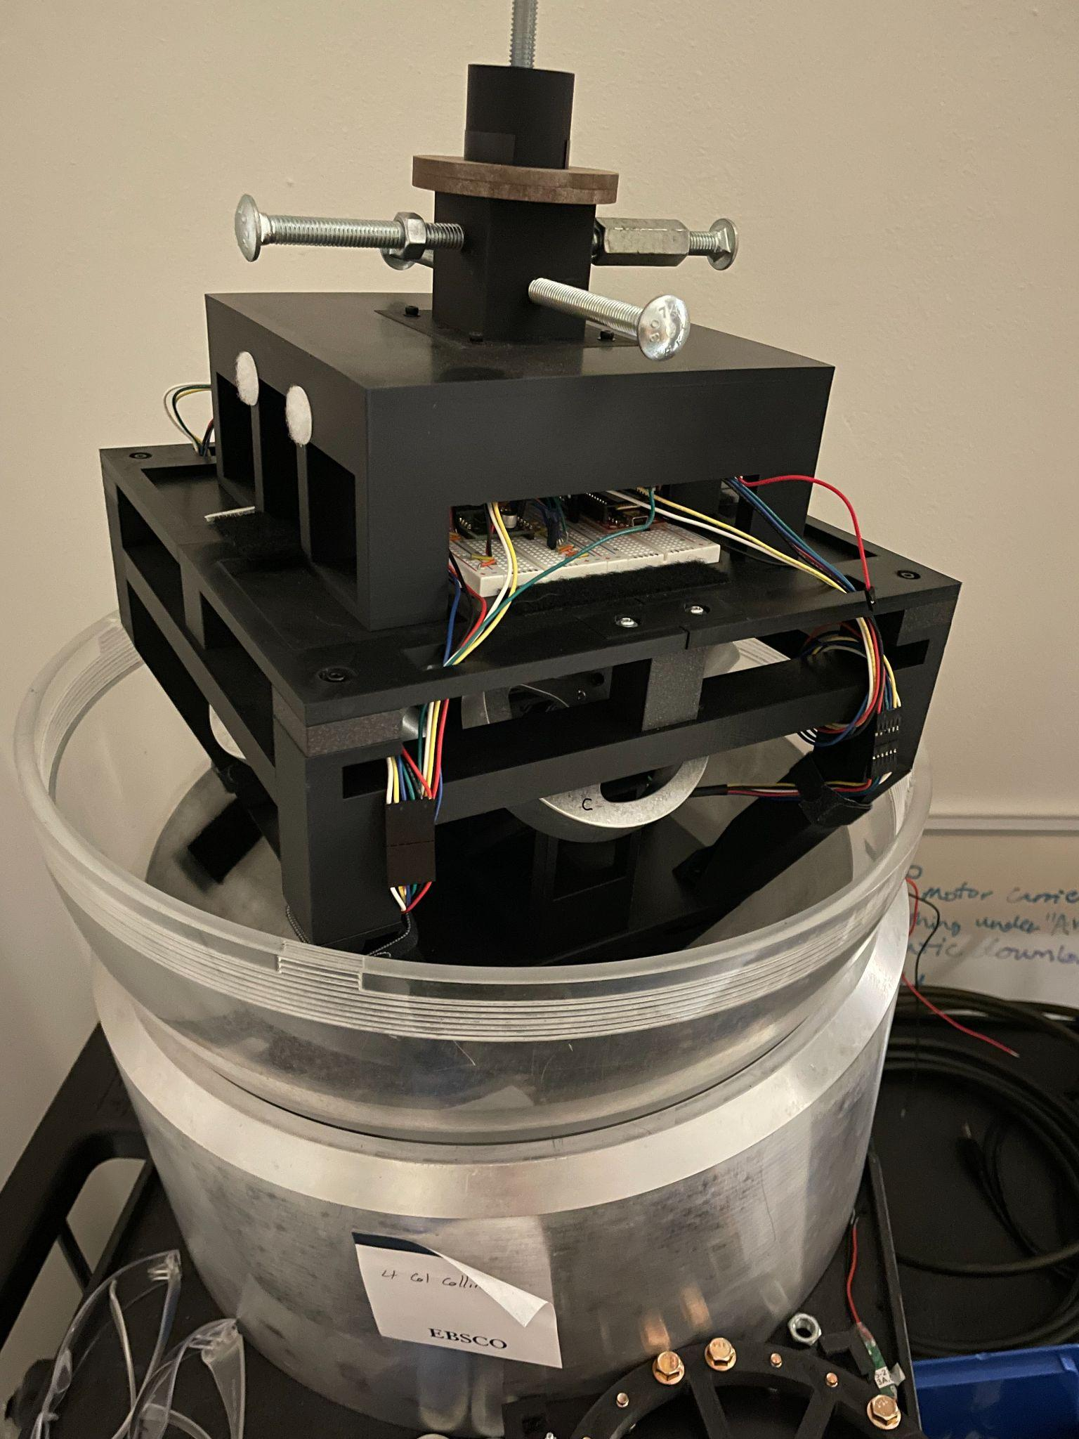
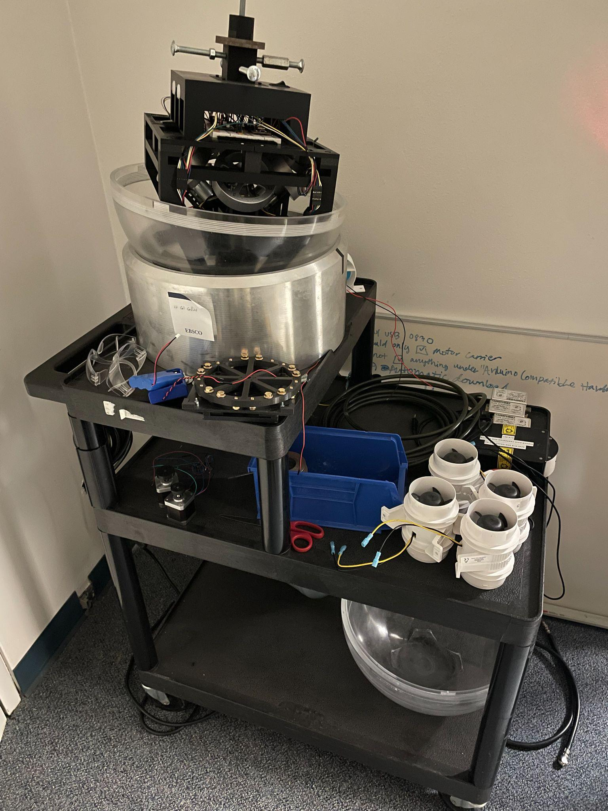
Overview
Using the small air bearing table, develop a reaction wheel control system in 3 degrees of freedom (pitch, yaw, roll).
Develop a robust sensor fusion algorithm using gyroscopes, magnetometers and accelerometers to accurately determine attitude at any given state.

Slide 3
Requirements
Primary Requirements:
The system shall maintain a specified heading without visible jitter or drift.
The system shall be able to determine true attitude +/- 1 degree in all 3 fundamental axes.
The system shall automatically detect simulated or real wheel failure and compensate, still fulfilling above requirements.
Stretch Requirement:
The system shall slew to a series of 4 points following the optimal path, coming within +/- 1 degree of each point in all 3 fundamental axes.

Slide 4
Requirements: Verification & Status
Requirement | Verification method / pass criterion | Status at review
(1) Hold heading, no visible jitter or drift | ARM on the free-floating table, hold yaw = 0 for 5 min, log attitude. Pass: |yaw error| < 1°, no visible oscillation | In progress: controller built and simulated; closed-loop test blocked by table balance
(2) Attitude ±1° in all 3 axes | Logged EKF vs. references: accelerometer level (roll/pitch), magnetometer + marked turns (yaw). Pass: error < 1° over the run | Roll/pitch verified at rest (σ = 0.02°). Yaw: 3 °/h after warm-up (replay); moving-table test next
(3) Detect wheel failure and compensate | Disable a wheel (command or unplug) during a hold. Pass: fault flagged < 1 s and (1), (2) still met | In progress: 3-wheel allocation implemented; detection not started
Stretch: 4-attitude optimal slew | Command 4 attitudes along quaternion (shortest) paths. Pass: each reached within ±1° | Planned: DEMO SPIN trajectory generator is reusable
Pass criteria for (1)–(3) are our proposed thresholds for instructor approval.

Slide 5
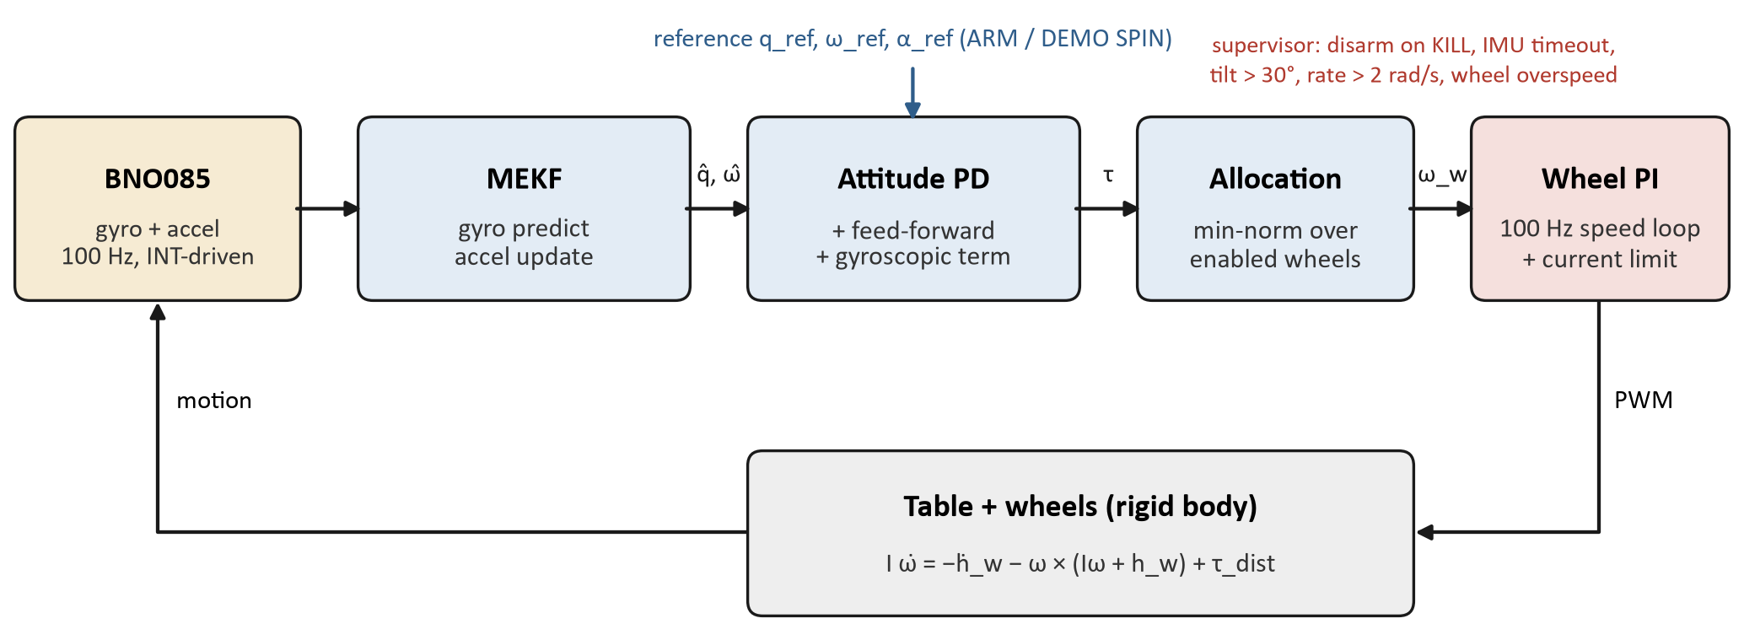
Theory: Estimation & Control Loop
Multiplicative EKF on the Teensy: 6 error states (3 attitude + 3 gyro bias), attitude kept as a quaternion
Predict at 100 Hz with the gyro; update with the accelerometer (gravity direction) → corrects roll and pitch; rejects samples when |a| is not ≈ 1 g (table accelerating)
Yaw is gyro-only: gravity carries no heading, and the magnetometer is disturbed by the wheel motors (see Data). The z-gyro bias comes from a 60–180 s calibration at rest
Frames: body z up, x = roll, y = pitch (right-handed); q maps inertial → body

Slide 6
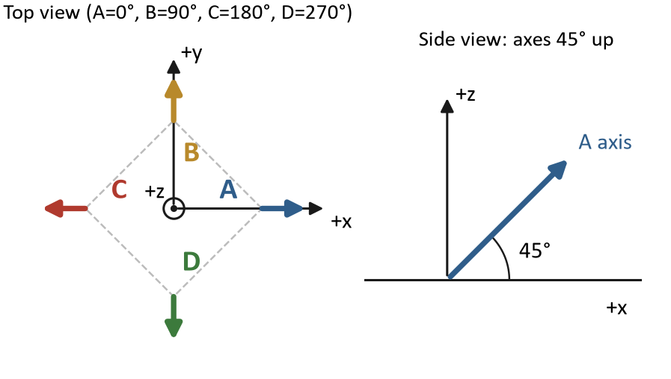
Theory: Control Law & Wheel Allocation
Quaternion PD with feed-forward:
τ = −Kp θₑ − Kd (ω − ω_ref) + I α_ref + ω × (Iω + h_w)
Kp = I ωₙ², Kd = 2ζ I ωₙ (ωₙ = 2 rad/s, ζ = 0.9)
4 wheels in a 45° pyramid: any 3 still span all axes → the basis for wheel-failure tolerance (Req. 3)
Minimum-norm allocation u = −D⁺τ over the enabled wheels; the 4th-wheel null mode [+1, −1, +1, −1] holds a bias speed
Inner loop: 100 Hz wheel-speed PI with a back-EMF current limit (2.5 A, no current sensor)
Physics limit: wheels cannot dump momentum. A constant torque τ fills them in h_max / τ seconds
Wheel J = 3.06×10⁻⁴ kg·m² (CAD); table I ≈ 0.062 kg·m² (model)
Speed limit 60 rad/s → ≈ 24 mN·m·s per tilt axis

Slide 7
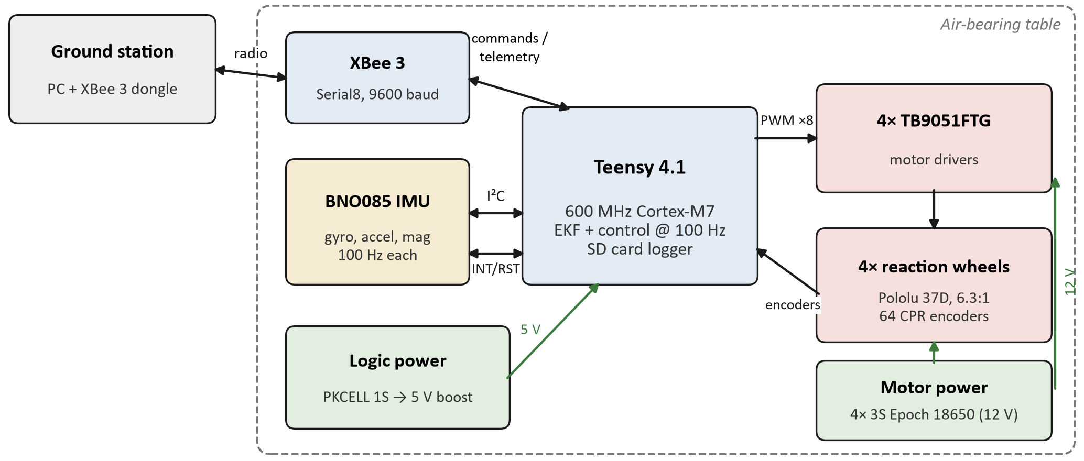
Build Progress: Hardware
Power system (Owen): separate logic pack + 5 V boost (verified 5.09 V), one 12 V pack per wheel, low-side motor switch, star ground, bench wiring sheet
Verified on the table: pin map and encoder wiring corrected, wheel/encoder signs set; gearboxes found to be 6.3:1, not 10:1 (hand-turn encoder counts)
Added IMU data-ready (INT) and reset (RST) wires → reliable 100 Hz data, no power cycle after uploads

Slide 8
Build Progress: Software & Test Campaign
Teensy firmware (C++, PlatformIO):
EKF, attitude controller, wheel allocation, wheel speed loops, safety supervisor
Logger: every sample to SD (100 Hz), live stream over XBee
XBee/USB commands: ARM, KILL, STATUS, SPEED, TEST, CALIBRATE, BEGIN STATIC TEST, MAG MAP, DEMO SPIN
SPEED manual closed-loop wheel mode with ramps and filtering (Owen)
Analysis: Python scripts on every logged run
Date | Test | Key result
10-08 | Wheel sign bring-up | Encoder pins corrected, signs set
10-15 | Bench speed sweeps, hand-turn counts | 6.3:1 gearing; A rubs; C oscillates
10-15 | Static IMU test (37 min) | Roll/pitch 0.02°; yaw −27 °/h; ¼ of samples lost
10-16 | Motors-on static test, MAG MAP | Gyro warm-up drift; magnetometer disturbance mapped
10-16 | First DEMO SPIN on air bearing | Table is pendulous; wheels saturate
10-20 | IMU INT/RST + driver fixes | Sample loss 25% → 0.085%

Slide 9
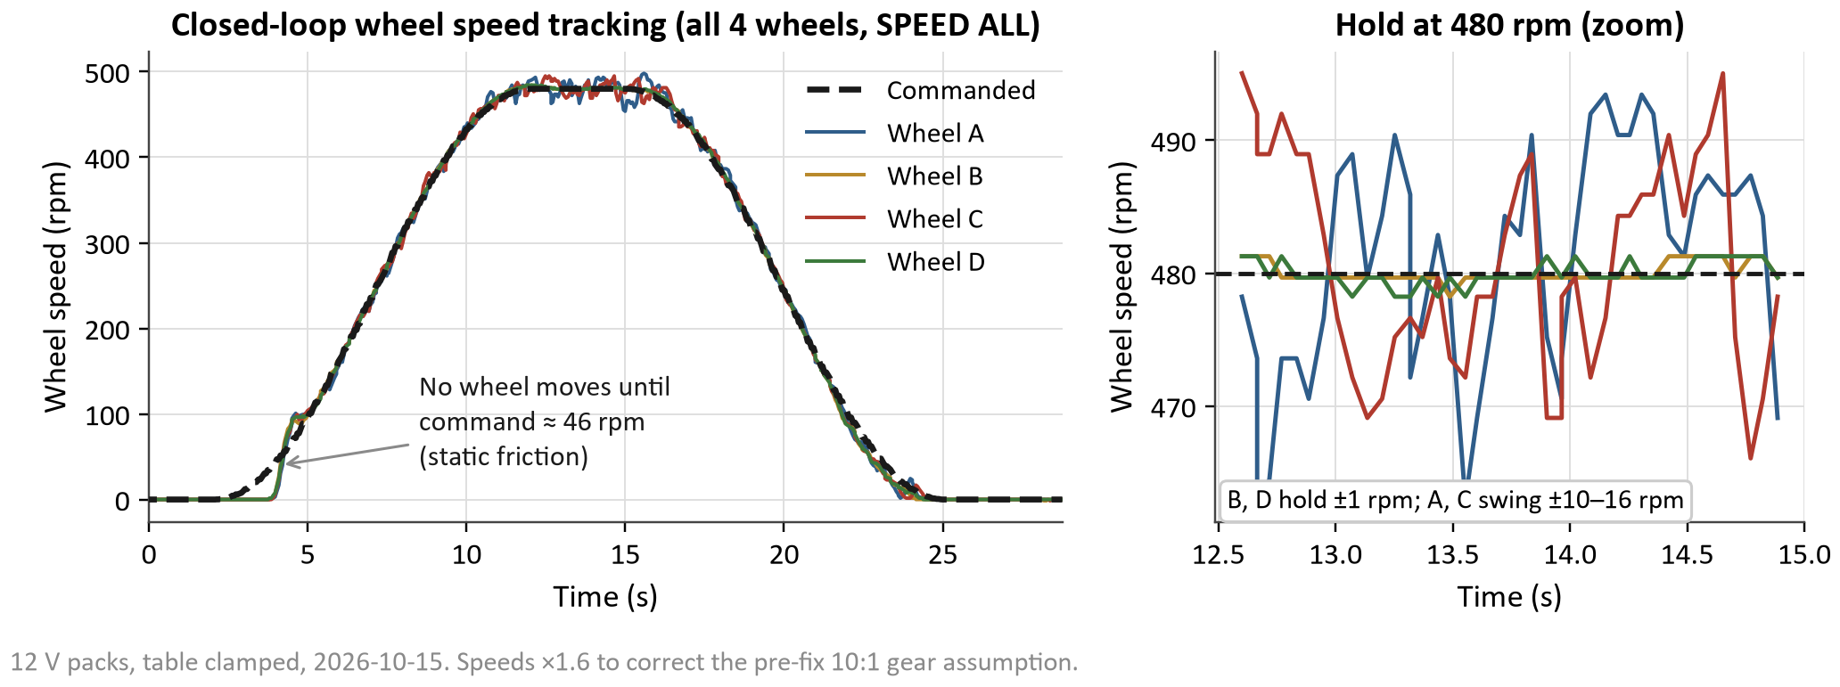
Data: Wheel Speed Control
MEASURE: Commanded vs. measured speed, all 4 wheels, 0 → 480 → 0 rpm cosine profile (12 V packs, table clamped).
COMPARE: Expected tight tracking from the 100 Hz PI + feed-forward. B and D hold ±1 rpm; A and C swing ±10–16 rpm; no wheel moves until the command reaches ≈ 46 rpm.
EXPLAIN: Same gains on every wheel, so A/C differences are hardware: A rubs and its pack is ≈1 V low; C is still unexplained. The start delay is static friction.
NEXT: Fix A’s rub and charge pack A; check C’s pack voltage under load and its encoder; add static-friction compensation.

Slide 10
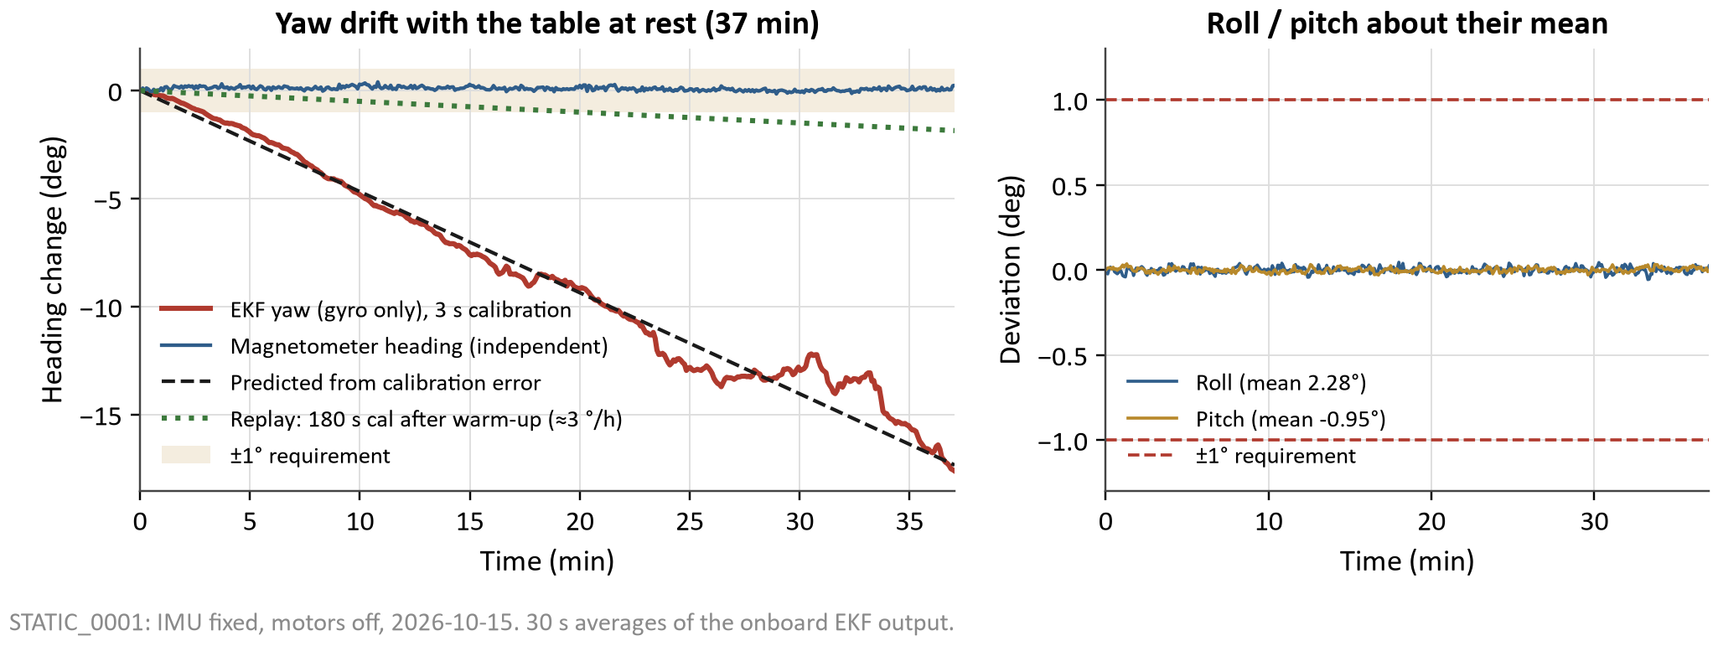
Data: Attitude Determination at Rest
MEASURE: 37 min with the IMU fixed and motors off: EKF roll/pitch/yaw plus the independent magnetometer heading.
COMPARE: Requirement ±1°. Theory: a 3 s gyro-bias average leaves ≈ 26 °/h of yaw drift.
EXPLAIN: Roll/pitch σ = 0.02°, far inside ±1°. Yaw drifted −27 °/h, matching the predicted calibration error; the magnetometer stayed flat. Fixes: 60–180 s calibration, z-bias lock, calibrate after a 10 min warm-up → ≈ 3 °/h in replay.
NEXT: Verify on the moving table; 3 °/h keeps yaw within ±1° for ≈20 min. Longer runs need a magnetometer aid.

Slide 11
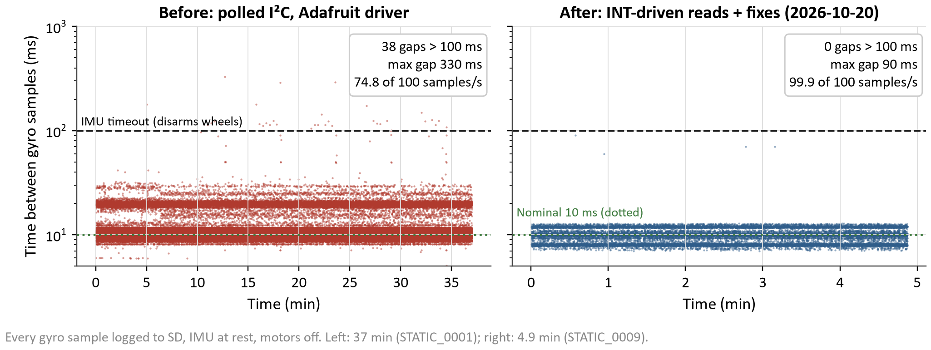
Data: IMU Data Integrity (Unexpected Result)
MEASURE: Time between every gyro sample logged to SD, IMU at rest, before and after our fixes.
COMPARE: Expected 10 ms. Before: 25% of samples lost and 38 gaps > 100 ms, each of which would have disarmed the wheels.
EXPLAIN: Root causes: the IMU library kept only the last report of each I²C read, SD writes blocked the loop, and no data-ready line. Fixed: INT/RST wired, own report queue, IMU serviced during SD waits, SD in DMA mode.
NEXT: Remaining 60–90 ms stalls come from inside the BNO085 (every ≈22 s): under the 100 ms timeout and now integrated by the EKF. Monitor on long runs.

Slide 12
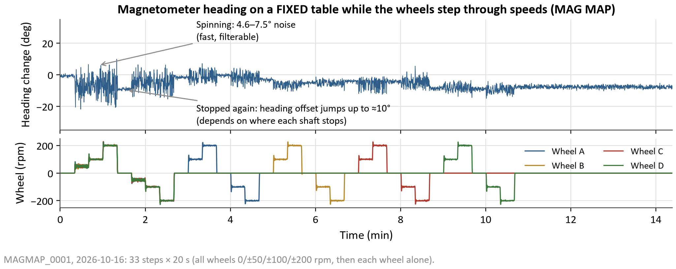
Data: Magnetometer vs. Wheel Motors
MEASURE: Raw magnetometer heading on a fixed table while the wheels step through ±50/100/200 rpm.
COMPARE: A heading aid must be steady to well under 1°; with motors off it showed 0.7° noise and no drift.
EXPLAIN: Spinning wheels add 4.6–7.5° of fast, filterable noise. Stopped wheels leave a random offset up to ≈ 10° set by where each shaft stops (motor magnets), so no fixed calibration exists → yaw stays gyro-only.
NEXT: DEMO SPIN keeps every shaft at ±100 rpm so offsets average out; calibrate hard iron from a full turn, then add a gated magnetometer yaw update.

Slide 13
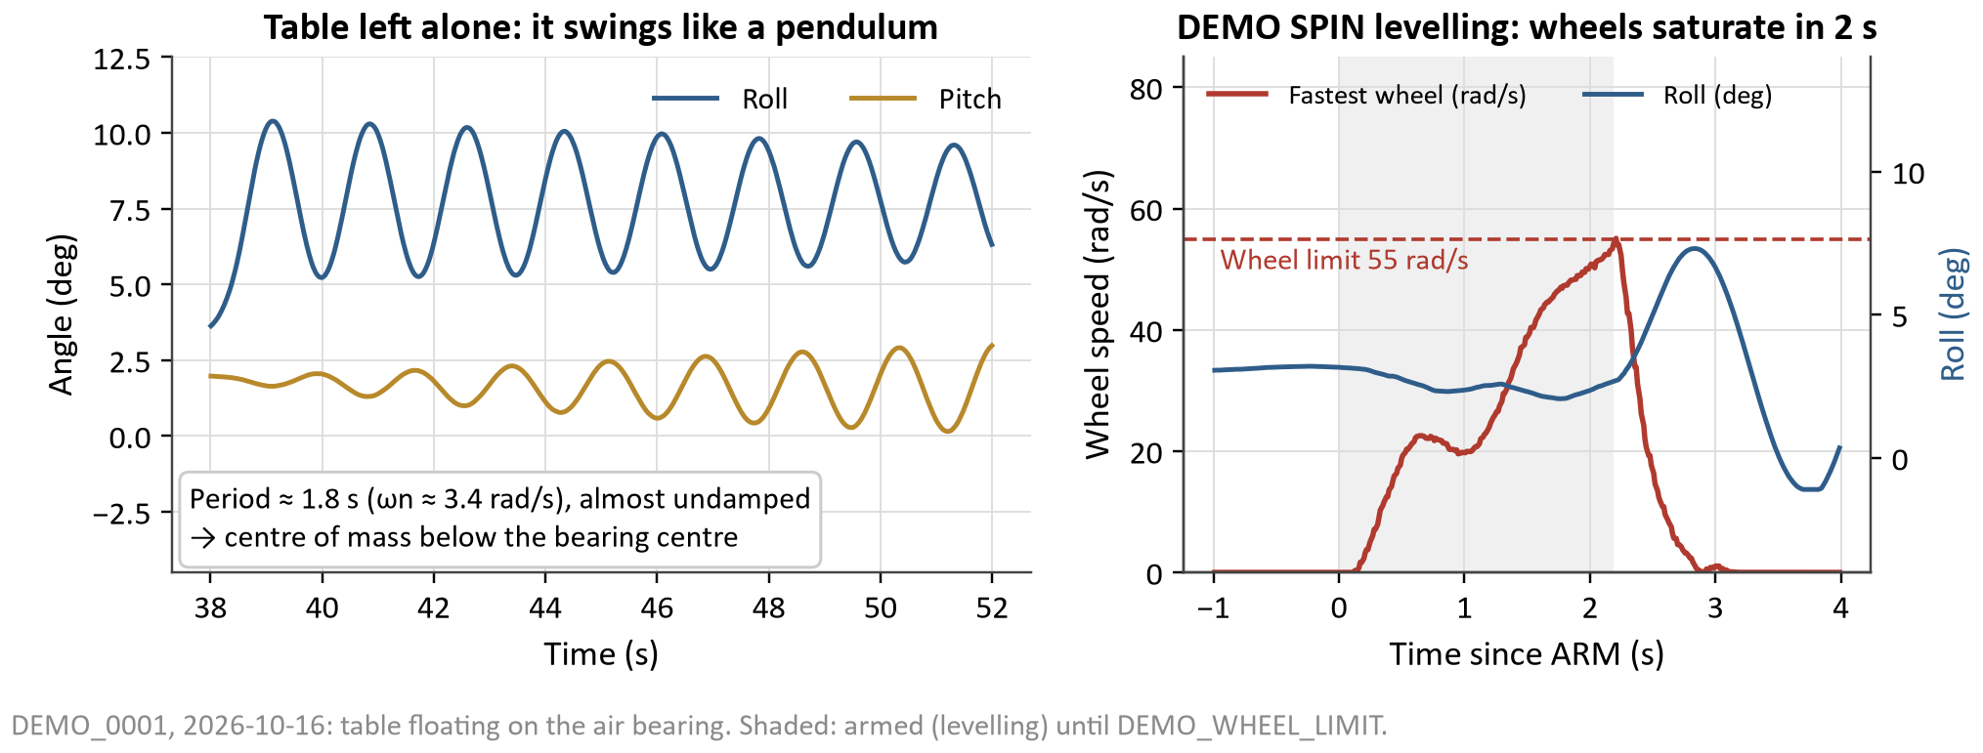
Data: First DEMO SPIN (Unsuccessful)
MEASURE: Roll/pitch and wheel speeds with the table floating; three DEMO SPIN attempts (level, then spin).
COMPARE: Simulation (CG at the bearing centre) levelled from 30° in ≈11 s. On the table each attempt hit the 55 rad/s wheel limit within 1–2 s.
EXPLAIN: The table is a pendulum: 1.8 s period, resting ≈3° off level. Gravity ≈ 16 mN·m per degree, so holding level needs ≈50 mN·m against ≈24 mN·m·s of wheel storage. Fits confirmed wheel signs and I ≈ 0.05–0.13 kg·m².
NEXT: Trim the balance so the table rests level; hold the natural tilt and spin about the vertical; add a BALANCE command.

Slide 14
Future Plans: Where We Stand
Working
Needs improvement
Remaining
Attitude estimator: roll/pitch 0.02° at rest
Reliable 100 Hz IMU data (0.085% lost)
Wheel speed loops on all 4 wheels at 12 V
SD + XBee logging and command link
Wheel geometry and signs verified on the air bearing
Table balance: pendulous, ≈3° off level
Yaw drift: ≈3 °/h after warm-up
Wheel A rub / pack; wheel C oscillation
Static friction at low wheel speed
Real inertia (fits 0.05–0.13 kg·m²)
Heading hold on the free table (Req. 1)
Yaw accuracy on a moving table (Req. 2)
Wheel-failure detection + 3-wheel control (Req. 3)
Stretch: 4-attitude optimal slew
Final demo and report

Slide 15
Future Plans: Path to Lesson 31
# | Next task | Verifies
1 | Trim table balance; add BALANCE command (reports resting tilt and gravity torque) | Enables hold
2 | ARM heading hold on the free table for 5 min, logged | Req. 1
3 | Yaw truth test: marked turns + hard-iron-calibrated magnetometer | Req. 2
4 | Wheel-failure detection: speed-tracking residual per wheel → drop to 3-wheel allocation | Req. 3
5 | 4-attitude slew along quaternion (shortest) paths | Stretch
Key risks
Balance limits hold time (wheels store only ≈24 mN·m·s per axis)
Yaw drift on long runs without a magnetometer aid
Wheel A/C hardware faults
Improvements beyond the baseline
Interrupt-driven IMU pipeline with per-sample logging (25% → 0.085% loss)
4-wheel pyramid + null-mode bias: fault tolerance and quieter magnetometer
Momentum-fit system ID of inertia and balance from flight data

Slide 16
GenAI Use Documentation
Tool: Claude Code (Anthropic), used by Derek from 30 Sep to 21 Oct
Firmware: drafted the EKF, controller, wheel allocation, IMU driver, logger and command set from the team’s requirements and design decisions; the team reviewed, uploaded and tested every build on the hardware
Analysis: wrote the Python scripts and plots for each test log; the team ran the tests and checked the conclusions
Documentation: CLAUDE.md, TODO.md, PROGRESS_LOG.md and a first draft of these slides
Team-owned: hardware build, wiring and power system (Owen), requirement and design decisions, all testing on the table, and final review of every result
Full record of work: PROGRESS_LOG.md and the git history in the team repository

